Slide 1
Secure Data Hiding In Images Using Steganography
CAPSTONE PROJECT
Presented By: SAGAR SHARMA
Student Name: SAGAR SHARMA

Slide 2
OUTLINE
Problem Statement
Technology used
Wow factor
End users
Result
Conclusion
Git-hub Link
Future scope

Slide 3
Problem Statement
Traditional encryption methods are easily detectable and can raise suspicion.
Need for a secure way to hide confidential messages within images.
Ensuring data security while maintaining the integrity of the cover image.
Making encryption and decryption accessible to non-technical users through a simple interface.

Slide 4
Technology used
Programming Language: Python
Image Processing Library: OpenCV
Graphical User Interface (GUI): Tkinter
File Handling & Security: Basic encryption logic for password protection
Platform: Windows

Slide 5
Wow factors
Embeds a message into an image via steganography without causing any discernible modifications.
GUI that is easy to use for encryption and decryption.
Pixel value manipulation in place of conventional encryption methods for lossless data concealment.
Any common image file type can be used, though PNG is suggested for optimal performance.

Slide 6
End users
Cybersecurity Enthusiasts – Exploring secure communication techniques.
Government & Defense – Secure message transmission without raising suspicion.
Journalists & Activists – Concealing sensitive information in images to avoid surveillance.
Software Developers – Learning steganography concepts and their applications.

Slide 7
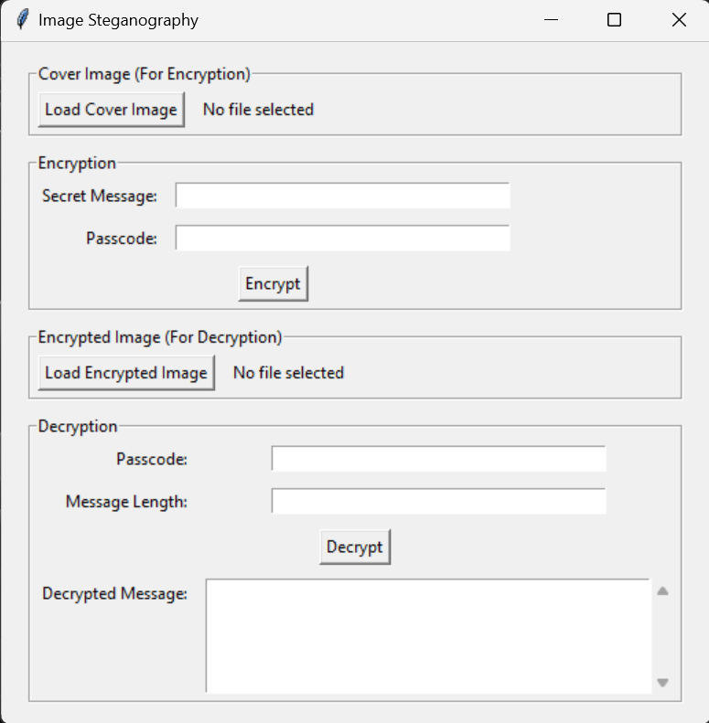
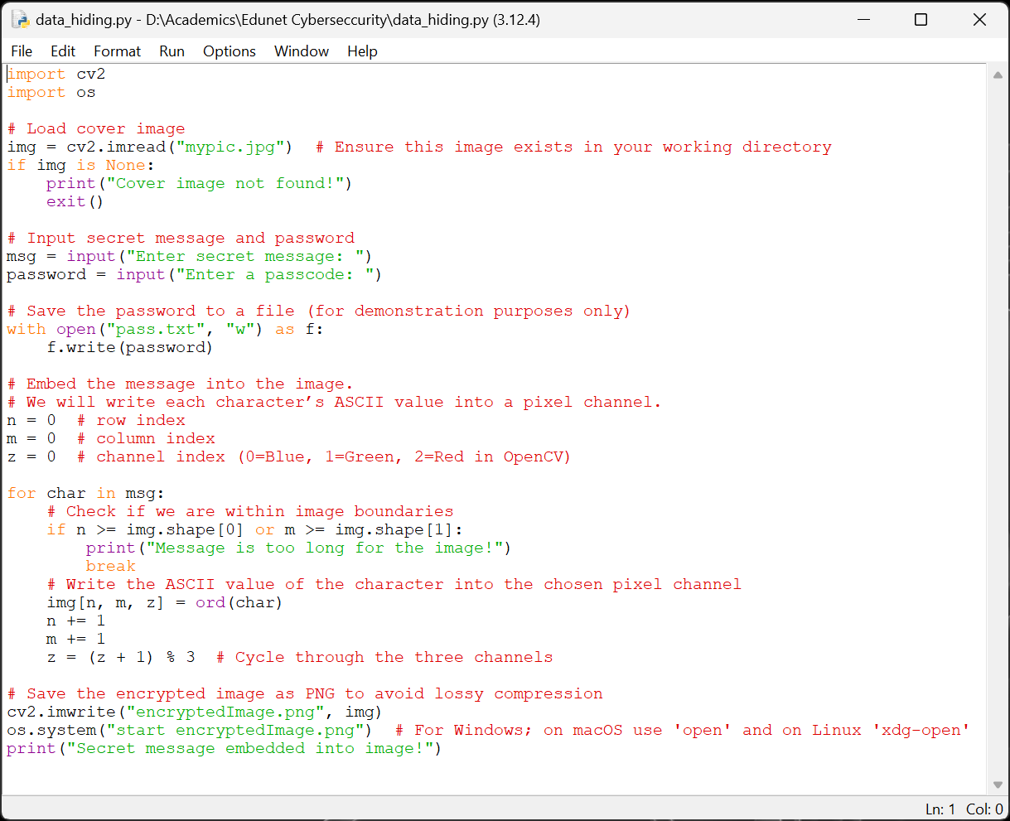
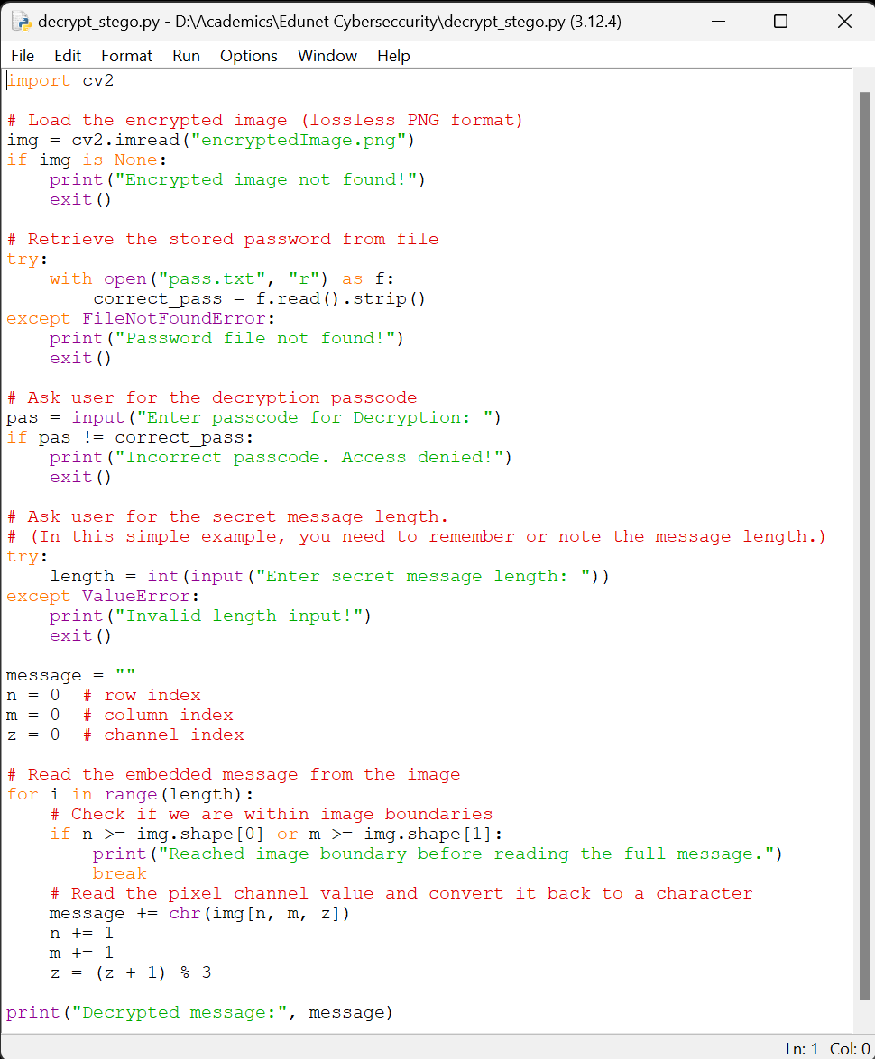


Results
GUI:
Encryption Code:
Decryption Code:
Input Image File:
Output Image File:

Slide 8
Conclusion
Steganography offers a secret method of sharing private data.
This project demonstrates how to implement message hiding in images in a straightforward yet efficient manner.
Even non-technical users may decrypt and encrypt data thanks to the GUI.
It may become more scalable, secure, and resilient with future advancements.

Slide 9
GitHub Link
https://github.com/Saagar1618/Edunet-Project.git

Slide 10
Future scope
Advanced Encryption Techniques – Integrate AES encryption before embedding text in images.
Support for Audio & Video Steganography – Expanding beyond images.
AI-based Detection Prevention – Ensuring messages stay undetectable from modern forensic tools.
Multi-Layer Security – Combining steganography with blockchain for ultra-secure communication.

Slide 11
THANK YOU

